Slide 1
Phonebook Directory
Member 1 Detail:- Name:- Abhishek Anand Section & Roll:- A-57
Enrollment No.- 12019002004061
Email ID:-abhianand2308@gmail.com
Member 2 Detail:- Name:- Jay Prakash Panday Section & Roll:- A-44
Enrollment No.- 12019002004044
Email ID:- jayprakashpandeyallen@gmail.com
Member 3 Detail:- Name:- Saurav Kumar Section & Roll:- A-48
Enrollment No.- 12019002004051
Email ID:- sauravkiul811310@gmail.com
Member 4 Detail:- Name:- Saurav Anand Section & Roll:- A-59
Enrollment No.- 12019002004064
Email ID:- sauravaanand700@gmail.com

Slide 2
OBJECTIVE
This system is developed using the general need required by the user while using the phone directory book and provided a lot of facility to their user. The objective of my Project Phone Book is to record the details various activities of user. It will simplify the task and reduce the paper work. The system is very user friendly and it is anticipated that administrators, academics, students and applicants will easily access functions of the system.

Slide 3
Project Technical Specification
C++ Language Used
Doubly Linked List Data Structure is used as backend to store data because by the used of Doubly Linked list we can easily traverse in both the direction and easily delete something.
To eliminate data redundancy and perform validation process background codes by the class will responsible to do this task.

Slide 4
METHODOLOGY
Admin module: This is the main module where the administrator logins into the database. All the admin details are stored with user id.
Create Contact module: This module allows the user to enter all the details like name, phone number and email id.
Insert module: In this module, all the details regarding contacts are inserted.
Delete module: In this module, the records with a specific id is deleted.
Display module: This module allows the user to view all contact details.
Search module: This module allows to search for the contact details by just entering its name.
If user will make any mistake while entering, they will be given a warning along with correction.

Slide 5
Database diagram
Database
Users
New Create, Edit, Search, Delete

Slide 6
Description
It is a friendly easy to use interface developed with data structure as the backend to store the details. This application stores all the details like name, telephone number and email id in a database. This system is developed to reduce the errors that creep up in manual systems. This software also allows to edit, update and search various contact details. It is secure, easy to use and reliable software system. It also provides a good level of security as there is an admin who can only edit and update details.

Slide 7
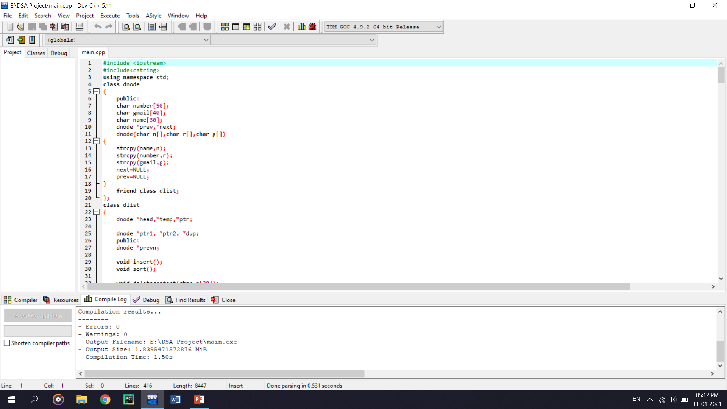
CODE SCREENSHOT
For implementing our code we used
Dev C++ Version 5.11

Slide 8
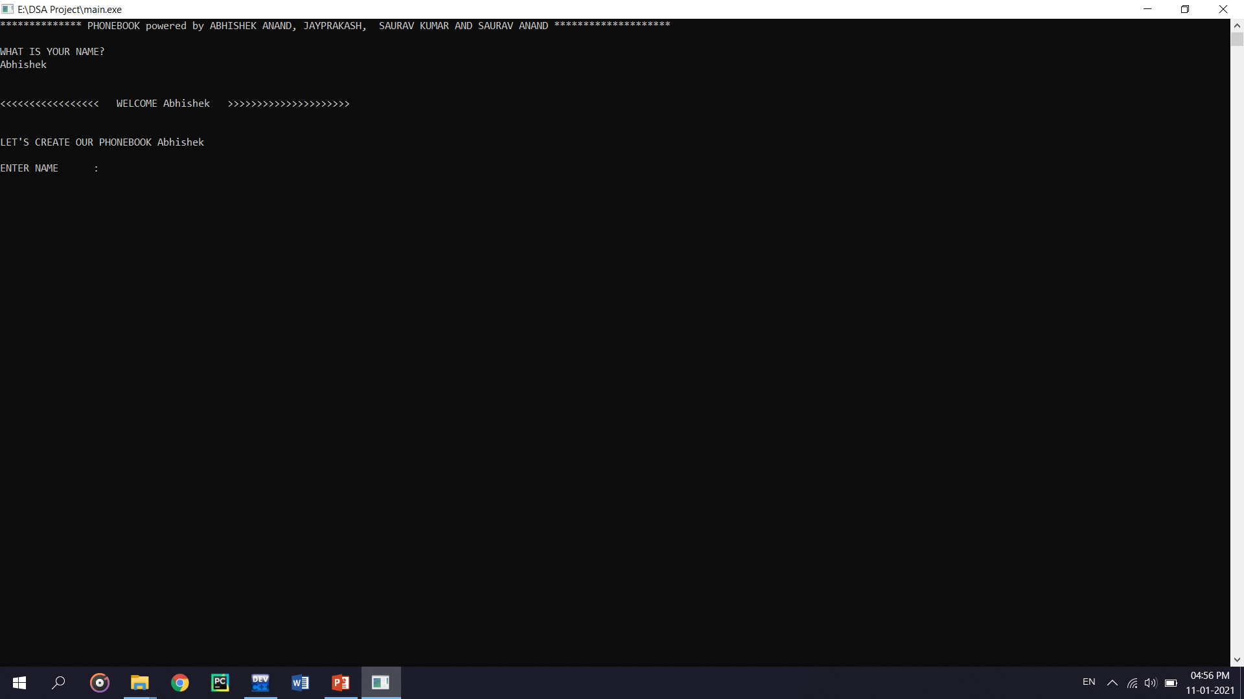
Results and output screenshots
Let’s Begin with its Output screen. First it will take users name so that only Admin can make changes in it.

Slide 9
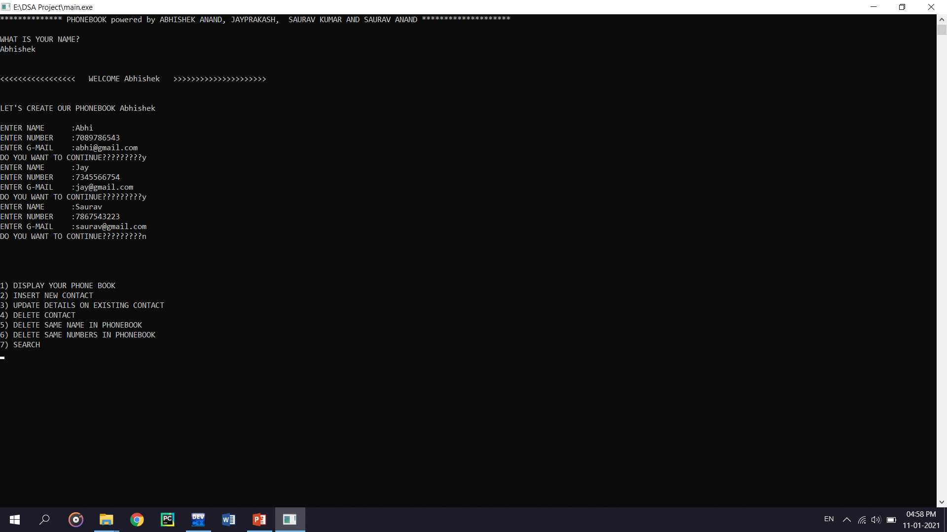
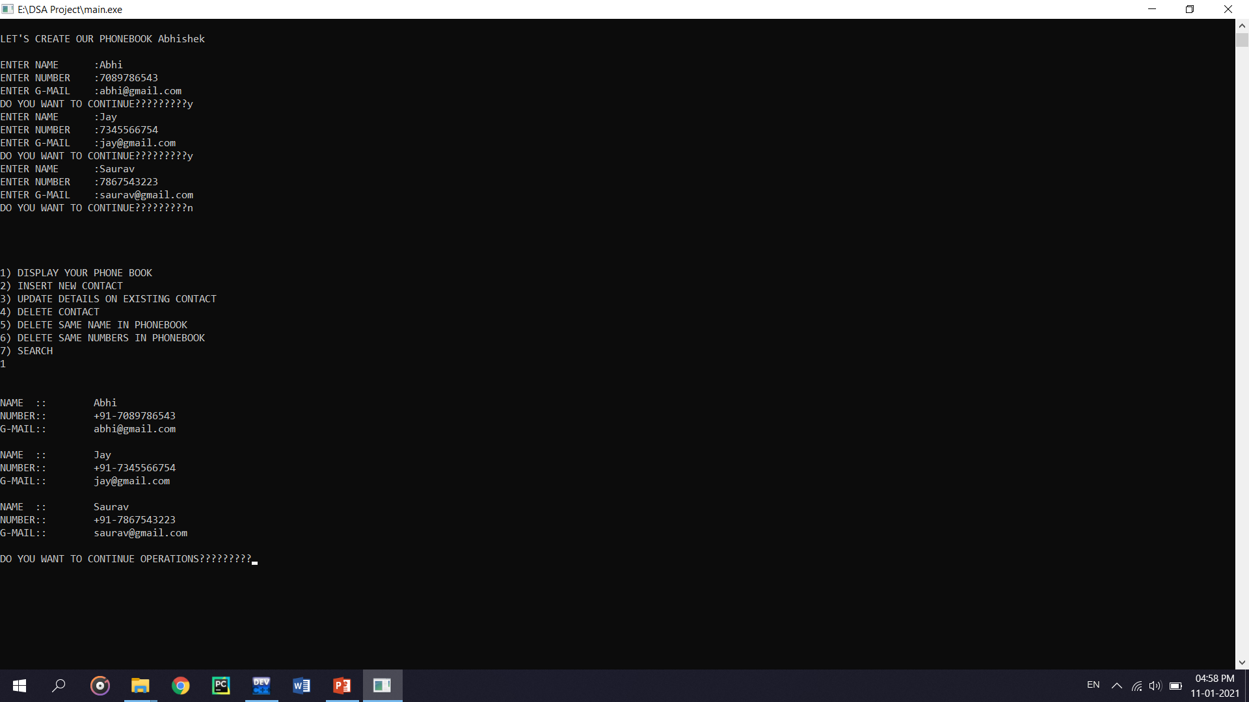
Screenshots for better understanding

Slide 10
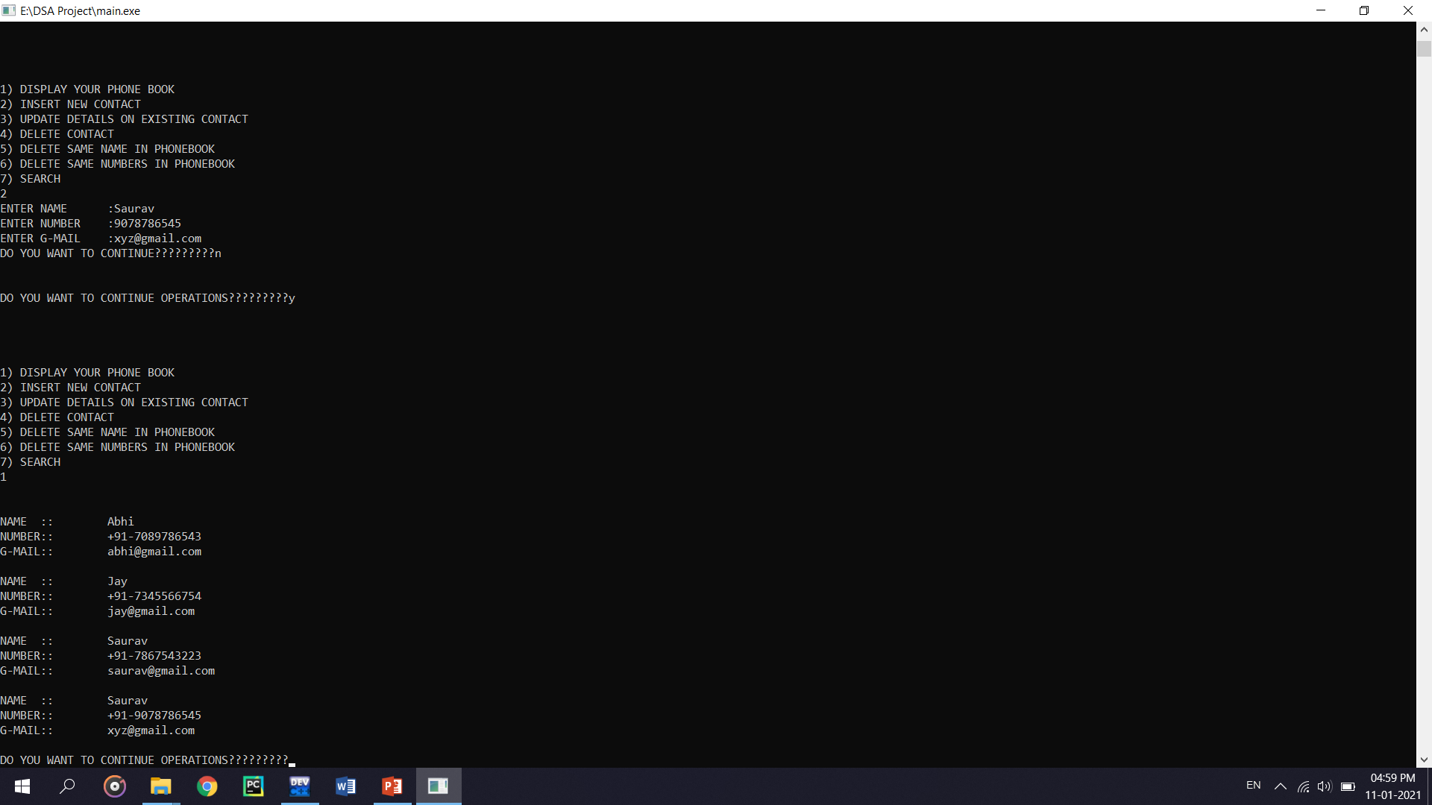
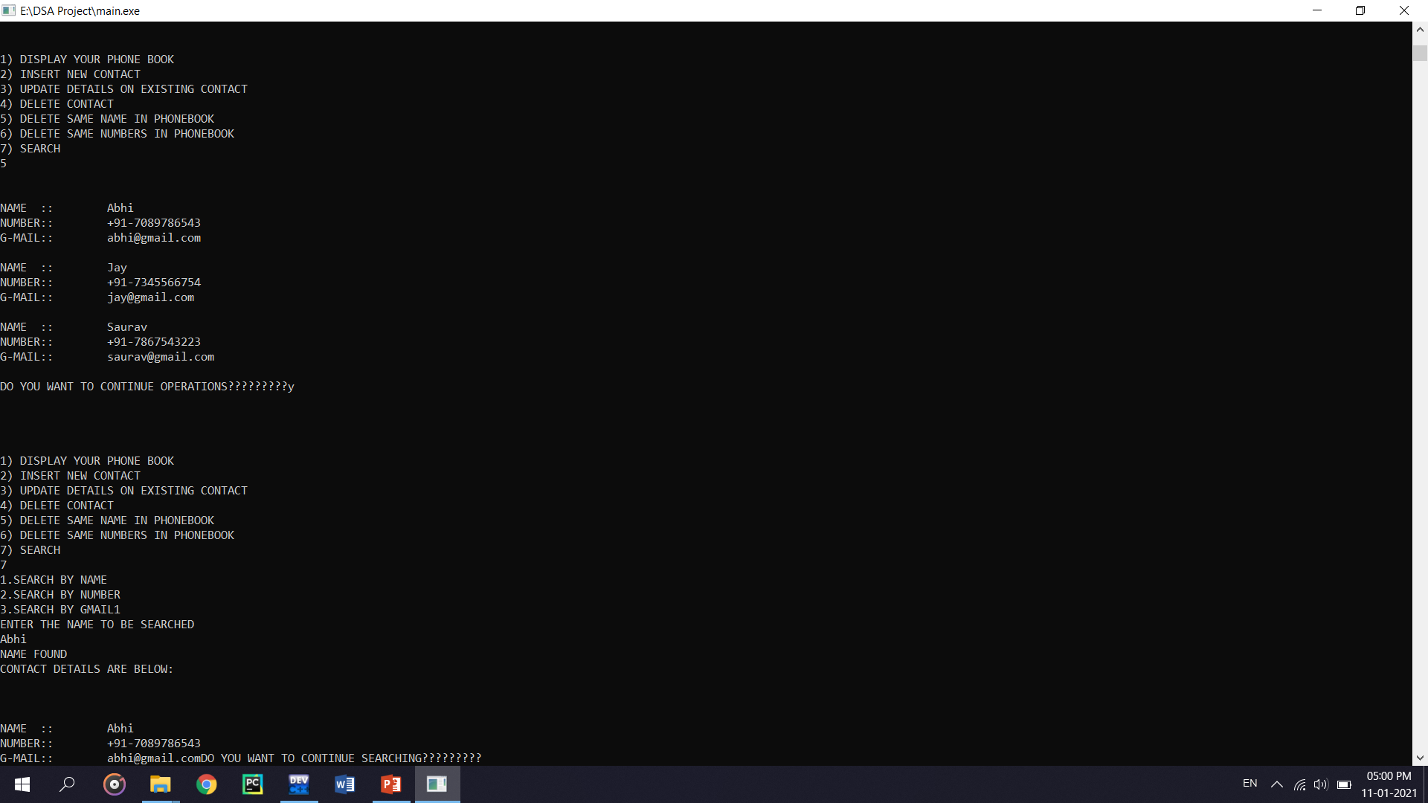
Screenshots for better understanding

Slide 11
CONCLUSION
By implementing this program, we can execute the contact data, delete data, searching, updating, exit and display Numbers. For creating this application we used arrays, pointer, structure and Doubly linked list. We have written the separate functions for all the operations that we can do in this application. We used C++ language for compilation of this program for the purpose of time and space complexity.

Slide 12


